Slide 1
Capstone Project Car accident severity
IBM Data Science Professional Certificate
Ajay Kumar Routh

Slide 2
INTRODUCTION AND BUSINESS UNDERSTANDING
All around the world, roads are shared by many motorized vehicles that have made transportation faster and more comfortable while supporting many countries’ economic and social development. Approximately 1.35 million people die each year because of road traffic crashes.
Almost 3,700 people are killed globally in road traffic crashes, where more than half of those killed are pedestrians, motorcyclists, and cyclists. The main business problem here is the severity of these accidents, which can sometimes be fatal and critical for pedestrians, bicycles, or vehicles. The project’s objective is to get people to safety, and the best way to solve this problem is to prevent those accidents of happening. Imagine being able to predict in advance the probability of an accident happening depending on the weather, the type of road, light conditions, junction type, driver’s influence of drugs before stepping inside a vehicle. This would help save many lives and help drivers get to their destination in the safest and fastest route possible.
This model is meant to alert drivers to remind them to be a little bit more careful, to switch roads or postpone their car rides.
There is another possible targeted audience for this study, the local police, health institutes, insurance companies etc. They can make good use of this model to know when to be fully ready to receive bad news about a specific road, and more importantly take prevention measures to avoid accidents on certain ones.

Slide 3
INTRODUCTION AND BUSINESS UNDERSTANDING
In most cases, carelessness while driving, using drugs and alcohol, or driving too fast are some of the main causes of accidents that can be avoided by implementing stronger regulations.
Besides the above reasons, weather, visibility, or road conditions and road types might be the major uncontrollable factors which can be avoided by uncovering patterns hidden in the data and declaring a warning to local government, police and drivers on the roads. targeted routes or alerting the drivers before the road trips.

Slide 4
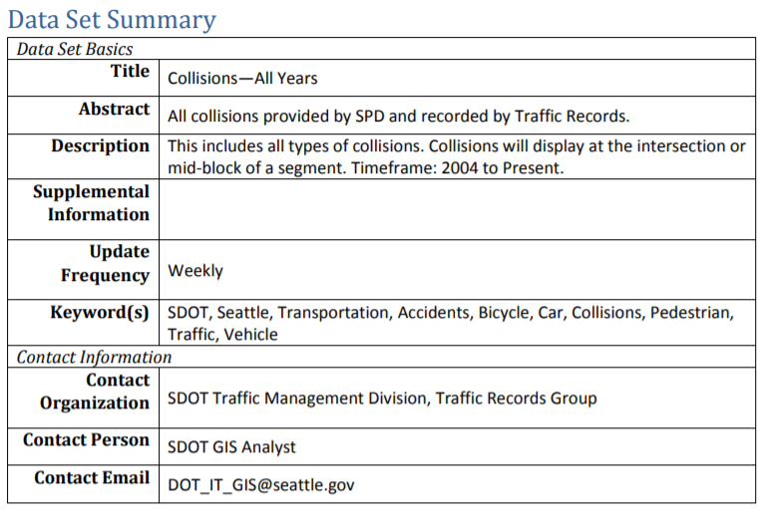
DATA UNDERSTANDING
For this project, the Dataset was shared on Coursera as a csv file.
It concerns the city of Seattle, WA and it is provided by Seattle Police Dept. and recorded by Traffic Records, with a timeframe from 2004 to Present. The data is composed of 38 features that accurately describe each car accident that happened in Seattle. They are classified in terms of severity, type of weather and road condition, location, address, influence of drugs, light conditions, fatalities etc. during an accident.

Slide 5
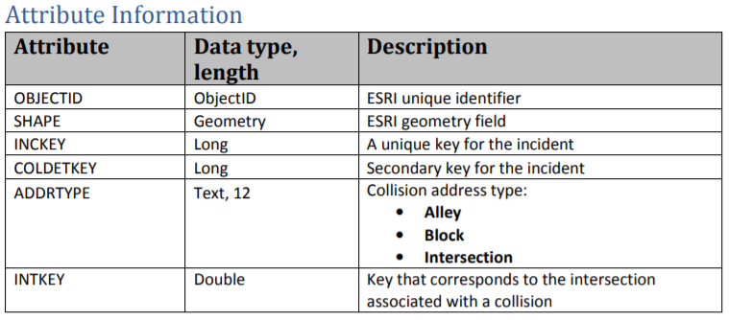
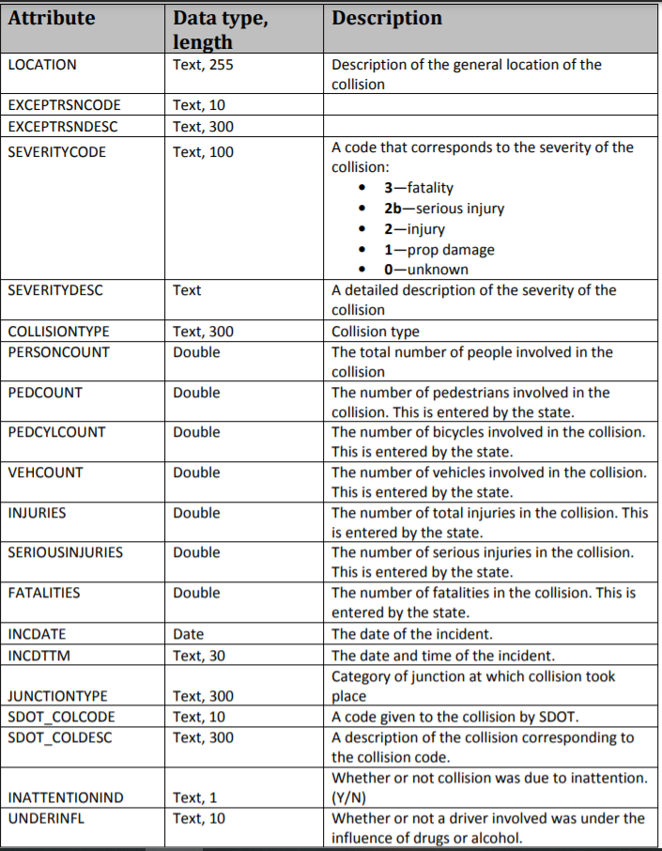
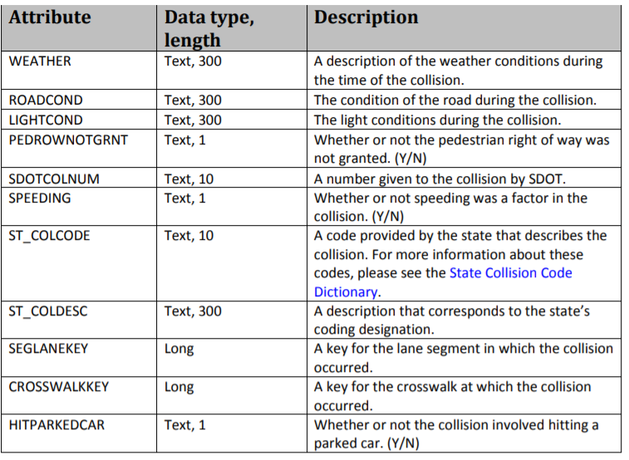
DATA UNDERSTANDING

Slide 6
DATA UNDERSTANDING
for this project, not all the attributes are useful as the main objective is to predict an accident’s probability and severity. Therefore, the Dataset needs deep understanding and analysis before choosing the right attributes to reach goal.
For example, SDOTCOLNUM, X, Y, LOCATION, INCDTTM, INCDATE, REPORTNO, COLDETKEY, INCKEY
and OBJECTID are features that give descriptive and detailed information about an accident, and are then not relevant to predict the severity of an accident in general. Moreover, EXCEPTRSNCODE, EXCEPTRSNDESC, PEDROWNOTGRNT, SPEEDING, INATTENTIONIND and INTKEY have a high number of missing data that would skew and bias our predictive model. We must select the most important features to weigh the severity of accidents in Seattle. Among all the features, the following features have the most influence in the accuracy of the predictions:
The 'WEATHER', 'ROADCOND','LIGHTCOND', 'UNDERINFL' and 'ADDRTYPE' attributes to predict ‘SEVERITYCODE’ attribute.
After selecting the appropriate features, the new Dataset is balanced and preprocessed before feeding it to a supervised machine learning model that will learn to predict in the future the probability of a car accident.

Slide 7
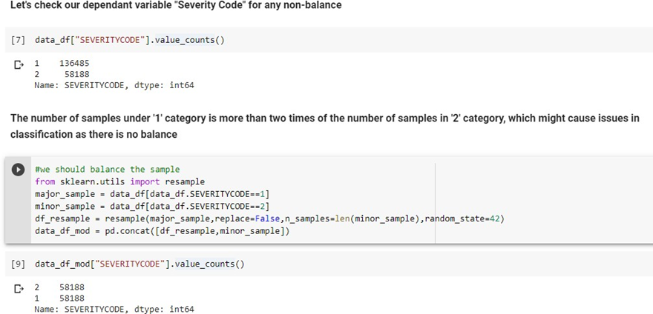
PREPROCESSING OF DATA
The null values from the new feature set are dropped and the Target variable balance is checked to avoid any bias for modelling Let us study the balance of our dataset, let’s check if the samples in the SEVERITYCODE column, have nearly equal value count.

Slide 8
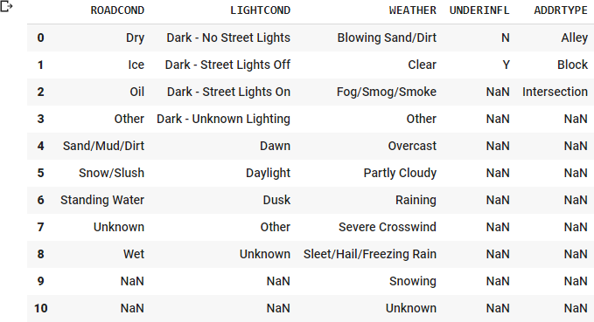
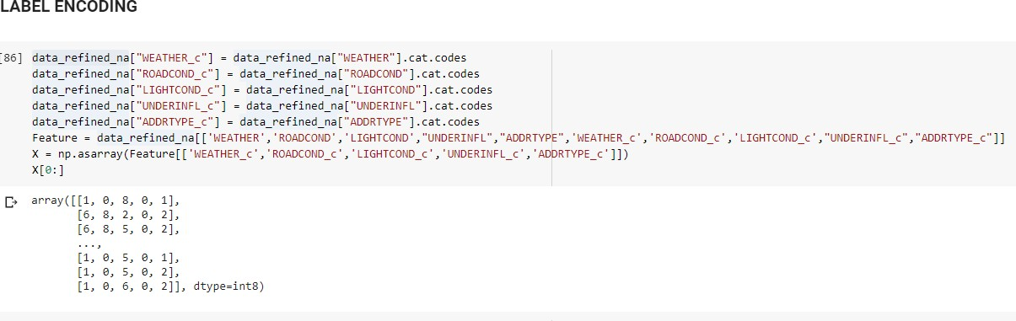
PREPROCESSING OF DATA
The sample is balanced after resampling and will have minimum skewness for modelling. To work with our features as categorical values, we should change the type of the columns for feature variable, and we will add 5 other columns containing the label encoding of categories in the 5 column attributes.
After type changing the category variables, we label encode the data and normalize the data to feed into models

Slide 9
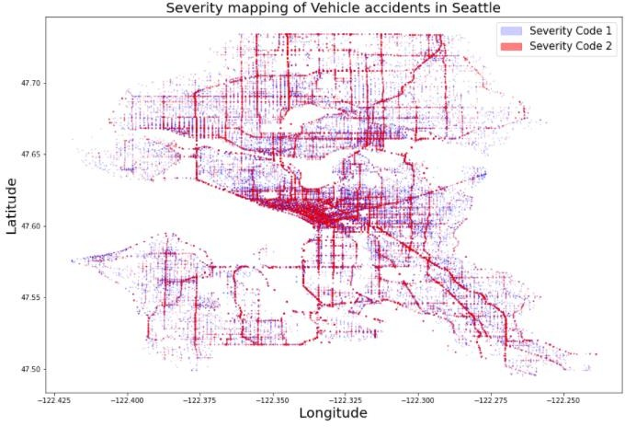
EXPLORATORY DATA ANALYSIS

Slide 10
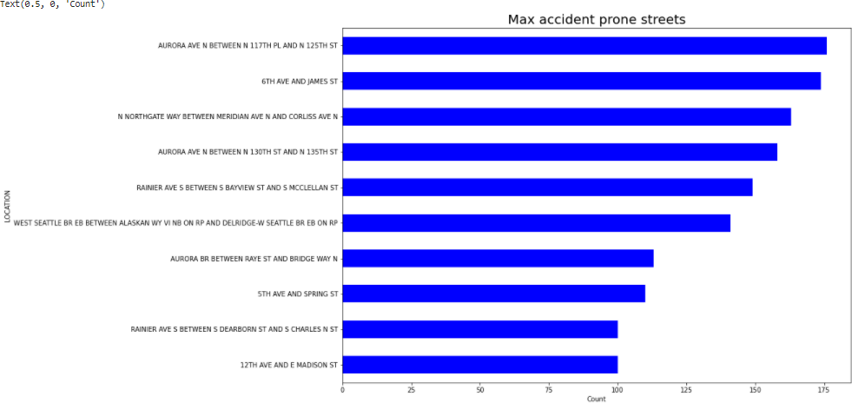
EXPLORATORY DATA ANALYSIS

Slide 11
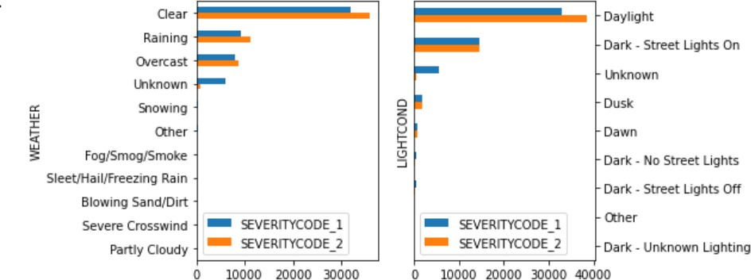
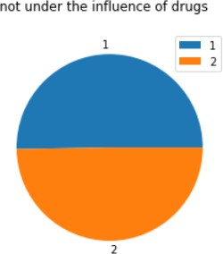
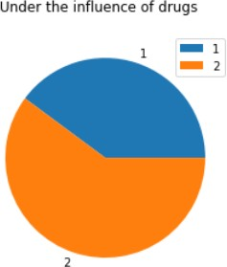
EXPLORATORY DATA ANALYSIS
Upon analyzing correlation between accidents (both type I and type II), "Clear" weather conditions and "Daylight" light conditions resulted in a greater number of type 1 and type 2 severity accidents, infers that accidents took place in safest of conditions possible
It appears that type 2 severity accidents have a higher proportion when the driver is under the influence of any drug or alcohol leading to a higher probability of injury than when the driver is sober.

Slide 12
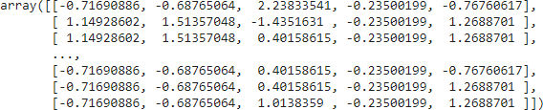
NORMALIZATION, SPLITTING AND CLASSIFICATION MODELLLING
After balancing SEVERITYCODE feature, and standardizing the input feature, the data has been ready for building machine learning models.
Normalizing the data
Standard scaler is used to normalize the feature set

Slide 13
CLASSIFICATION MODELS
K-Nearest Neighbors (KNN): The k-nearest neighbors (KNN) algorithm is a simple, supervised machine learning algorithm that can be used to solve both classification and regression problems. ... In the case of classification and regression, we saw that choosing the right K for our data is done by trying several Ks and picking the one that works best.
Decision Tree: A decision tree is a decision support tool that uses a tree-like model of decisions and their possible consequences, including chance event outcomes, resource costs, and utility. It is one way to display an algorithm that only contains conditional control statements.
Logistic Regression: In statistics, the logistic model is used to model the probability of a certain class or event existing such as pass/fail, win/lose, alive/dead or healthy/sick. This can be extended to model several classes of events such as determining whether an image contains a cat, dog, lion, etc.

Slide 14
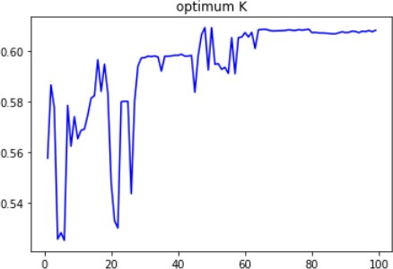
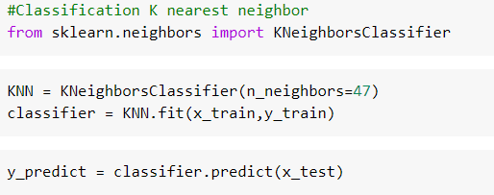

K-Nearest Neighbour
K in the range of 47-50 has given optimum score
K=47 is based on the optimum plot to find maximize score

Slide 15
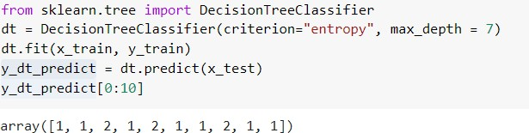
Decision Tree

Slide 16
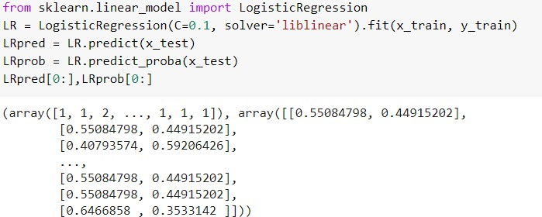

Logistic Regression

Slide 17
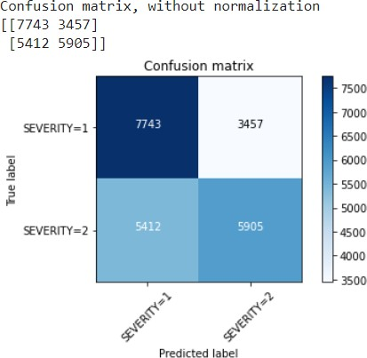
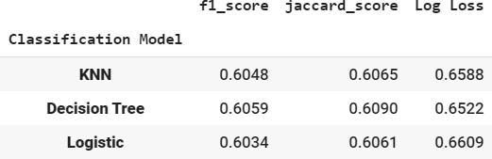
DISCUSSION
These are the results of the inferential statistical testing performed using Jaccard score, f1 score and log loss as evaluation metrics. All the three models performed on almost the same accuracy. The model with the highest performance is the Decision Tree with a log loss of 65.2% and f1 score approximately like its Jaccard score with a value of 60.9%. Overall, there was still significant variance that could not be predicted by the models in this study, the algorithms have low scores and need more pre-processing.
Logistic regression confusion matrix shows that the model is good at predicting
We can still improve the above models, by better tuning of the hyperparameters like the “k” in KNN, the “max-depth” in the Decision Tree, and the “C” parameter in the Logistic Regression.

Slide 18
CONCLUSION
In this study, our goal was to predict accurately the severity type of an accident depending on the selected features
The results can have a better performance, a lot of improvement can be done on class 1 and 2 predictions. These models can be very useful in helping weather stations or news program alert drivers of the probabilities of car crashes and its type of severity, we can also conclude that particular weather, road, light, drug influence and road intersection types have an impact on whether or not the car ride could result in one of the two classes property damage (class 1) or injury (class 2)

